Slide 1
Face Recognition System

Slide 2
HELLO!
Group :- G4
====Group Members====
1.Barot Poojan B.(19BEIT30052)
2.Patel Manthan B.(19BEIT30041)
3.Thakor Krunal M.(19BEIT30037)
4.Panchal Jigar K.(19BEIT30032)

Slide 3
Preface
Introduction
About Face Recognition
Four Stages of the system
Image Processing
Modules and Algorithm
Advantages
Disadvantages
Screenshots
Conclusion
Future Scope
1

Slide 4
Introduction
Every actions are increasingly being handled electronically, instead of pencil and paper or face to face.
This growth in electronic transactions results in great demand for fast and accurate user identification and authentication.
1
1

Slide 5
Introduction
In this paper, we propose a system that takes the attendance of student for classroom lecture. Our system takes the attendance automatically using face recognition.
Here a face is undeniably connected to its owner expect in the case of identical twins.
1
1

Slide 6
Face Recognition?

Slide 7
Face Recognition
It requires no physical interaction on behalf of the user.
It is accurate and allows for high enrollment and verification rates.
It can use your existing hardware infrastructure, existing cameras and image capture Devices will work with no problems.
1
1

Slide 8
Face Recognition
In Facial Recognition there are two types of comparisons:-
VERIFICATION- The system compares the given individual with who they say and gives a yes or no decision.
IDENTIFICATION-The system compares the given individual to all other individuals in the database and gives a ranked list of matches.
1
1

Slide 9
Four Stages of authentication

Slide 10
Identification on authentication technologies operate using the following four stages:-
Capture: A physical or behavioural sample is captured by the system during enrolment and also in identification or verification process.
Extraction: Unique data is extracted from the sample and a template is created.
Comparison: The template is then compared with a new sample.
Match/non-match: The system decides if the features extracted from the new samples area match or a non match.
1
1

Slide 11
Image Processing

Slide 12
Image Processing
Images are cropped such that the avoid facial image remains, and color images are normally converted to black and white in order to facilitate initial comparisons based on grayscale characteristics.
First the presence of faces or face in a scene must be detected.
Once the face is detected , it must be localized and Normalization process maybe required to bring the dimensions of the live facial sample in alignment with the one on the template.
1
1

Slide 13
How IT Works?
Facial recognition software is based on the ability to first recognize faces, which is a technological feat in it self. If you look at the mirror, you can see that your face has certain distinguishable landmarks. These are the peaks and valleys that make up the different facial features.
VISIONICS defines these landmarks as nodal points. These are about 80 nodal points on a human face.
1
1

Slide 14
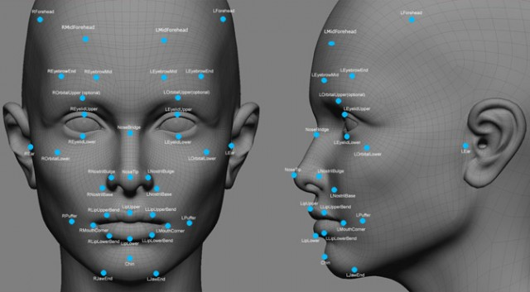
1
1
1

Slide 15
Modules and Algorithm
We have used:-
Tkinter
Ttk
PIL
OS
Opencv
Numpy
LBPH algorithm

Slide 16
Advantages
It can search against static images such as driver’s Licence photographs.
It is the inly biometric able to operate without user cooperation.
Get Rid of pen & paper system.
Data is collected and stored automatically.
1
1

Slide 17
`Disadvantages
Difficult to maintain and repair.
System is ineffective if there is no power supply
30-40% perfection.
1
1

Slide 18
Screenshots

Slide 19
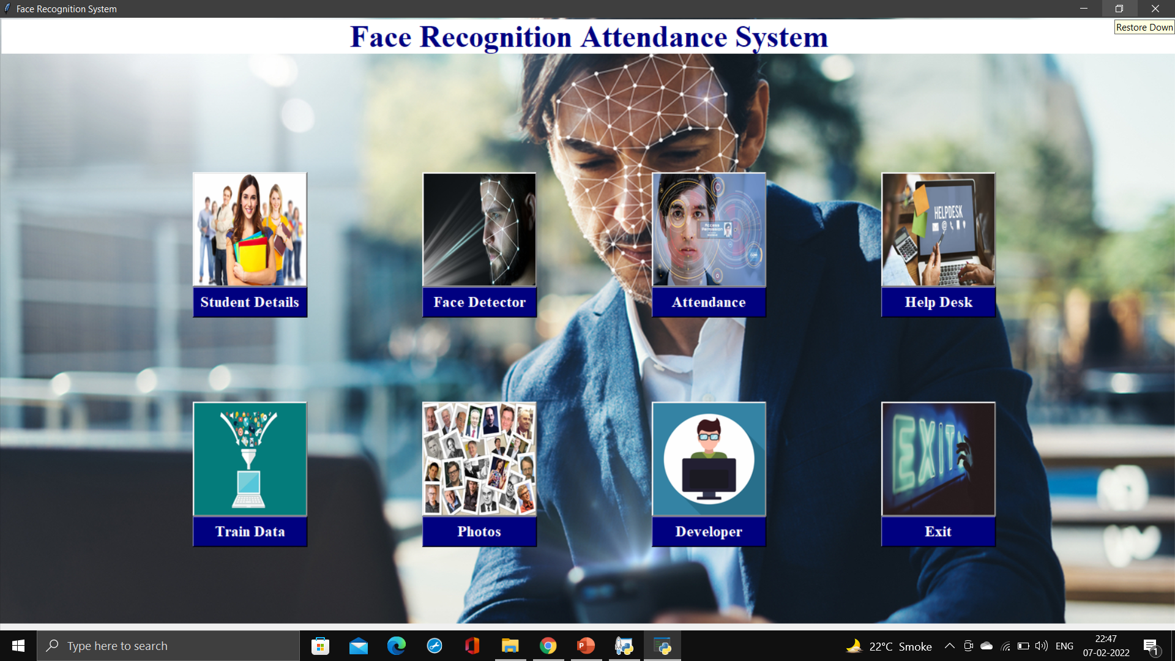
Home window

Slide 20
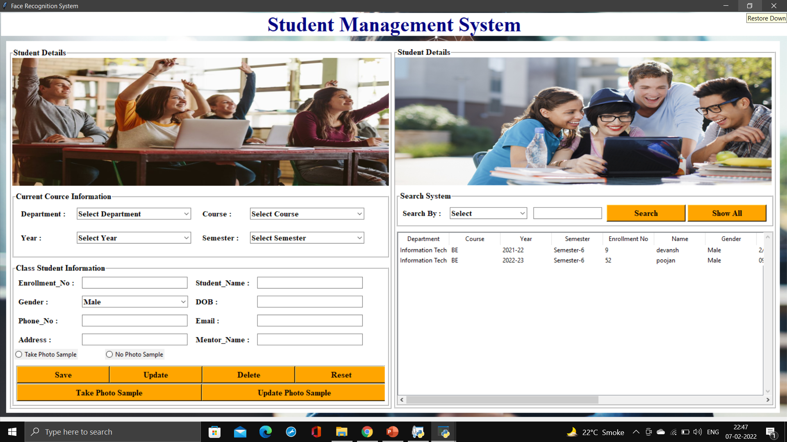
Student Detail

Slide 21
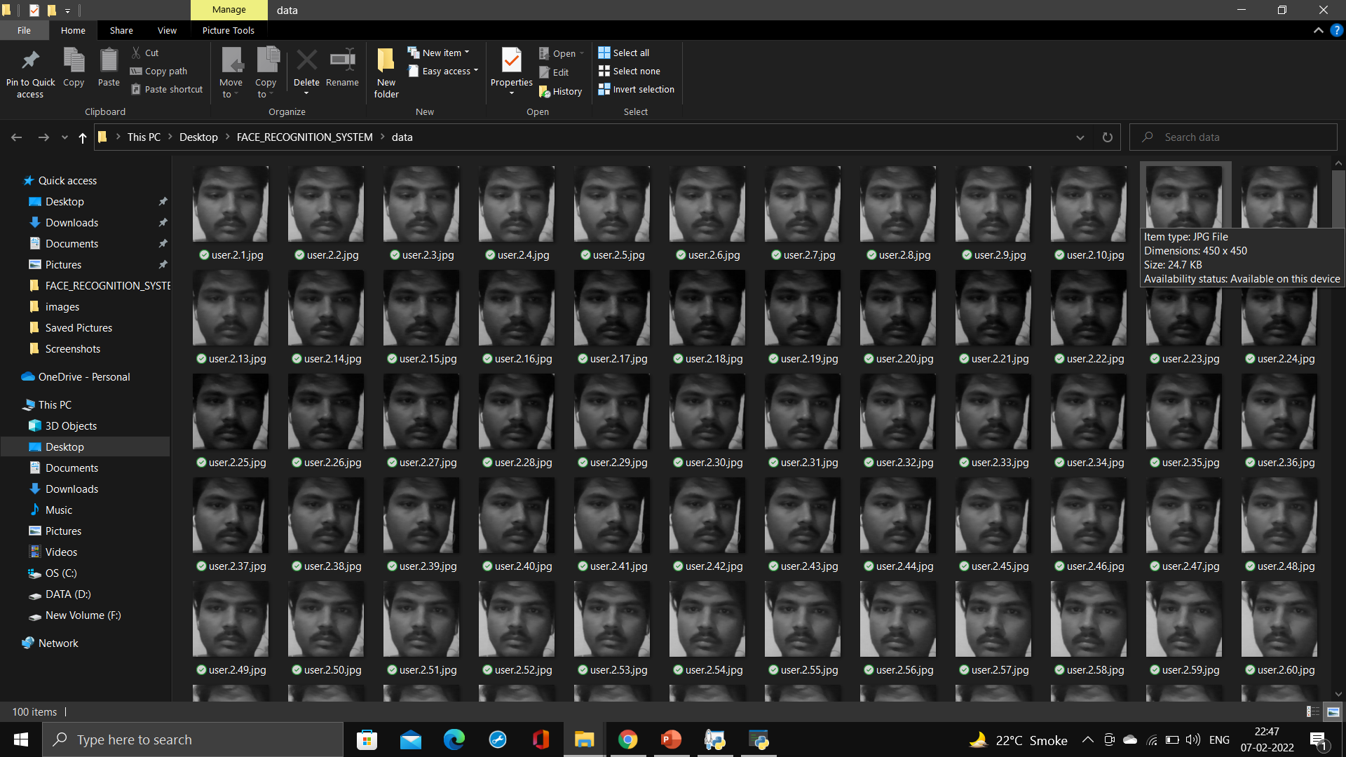
Photo Samples

Slide 22
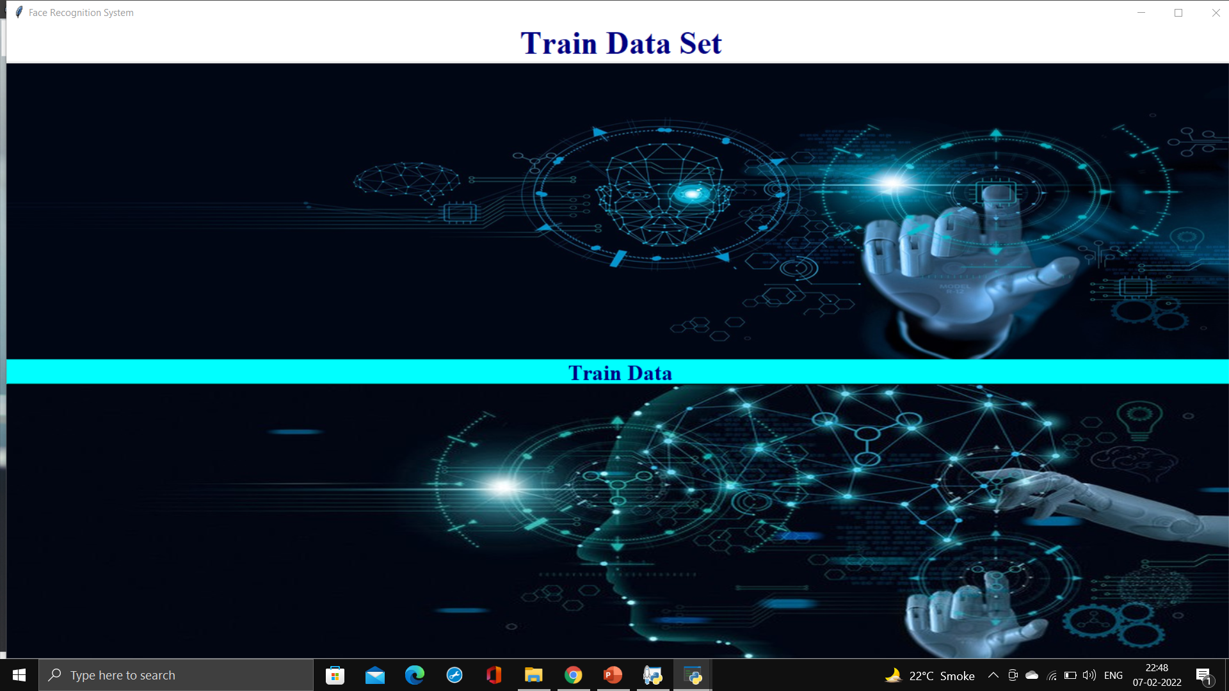
Training Phase

Slide 23
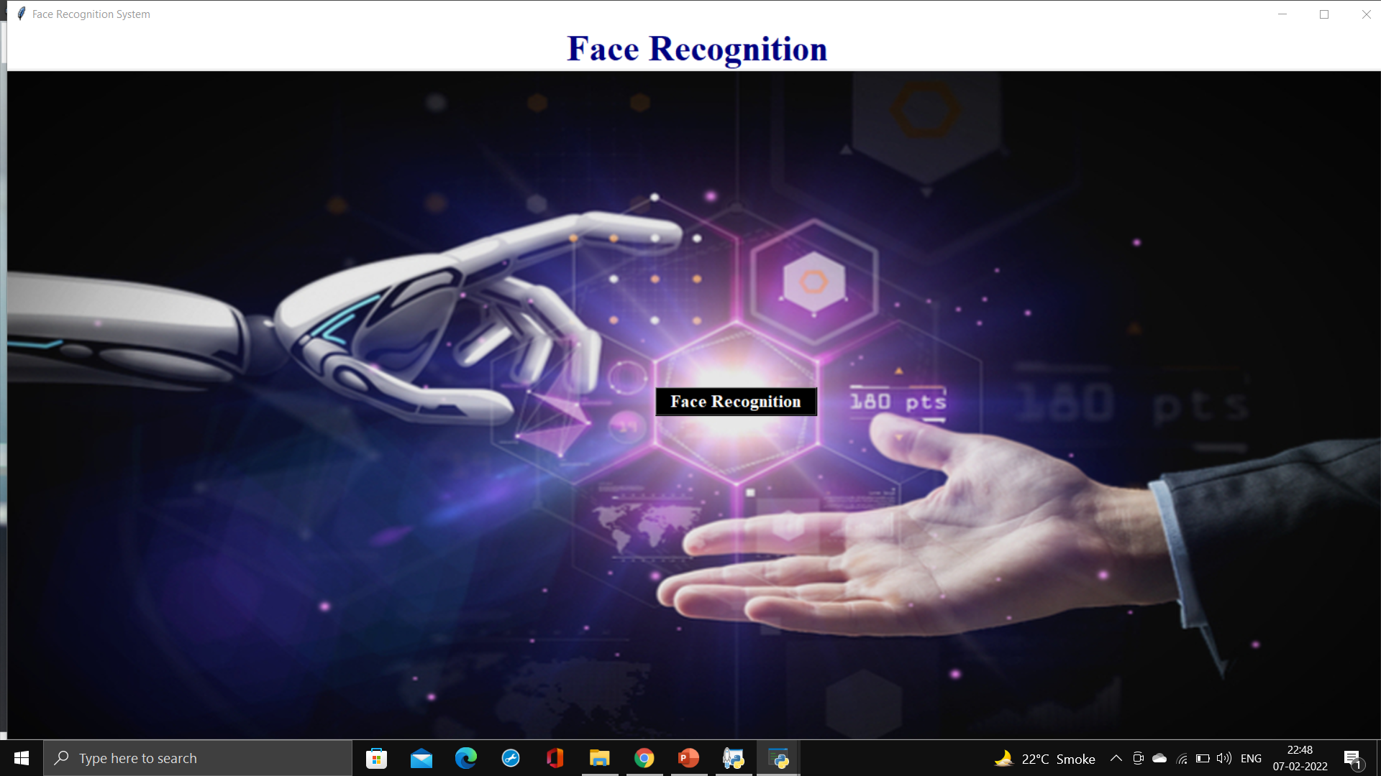
Face Recognition

Slide 24
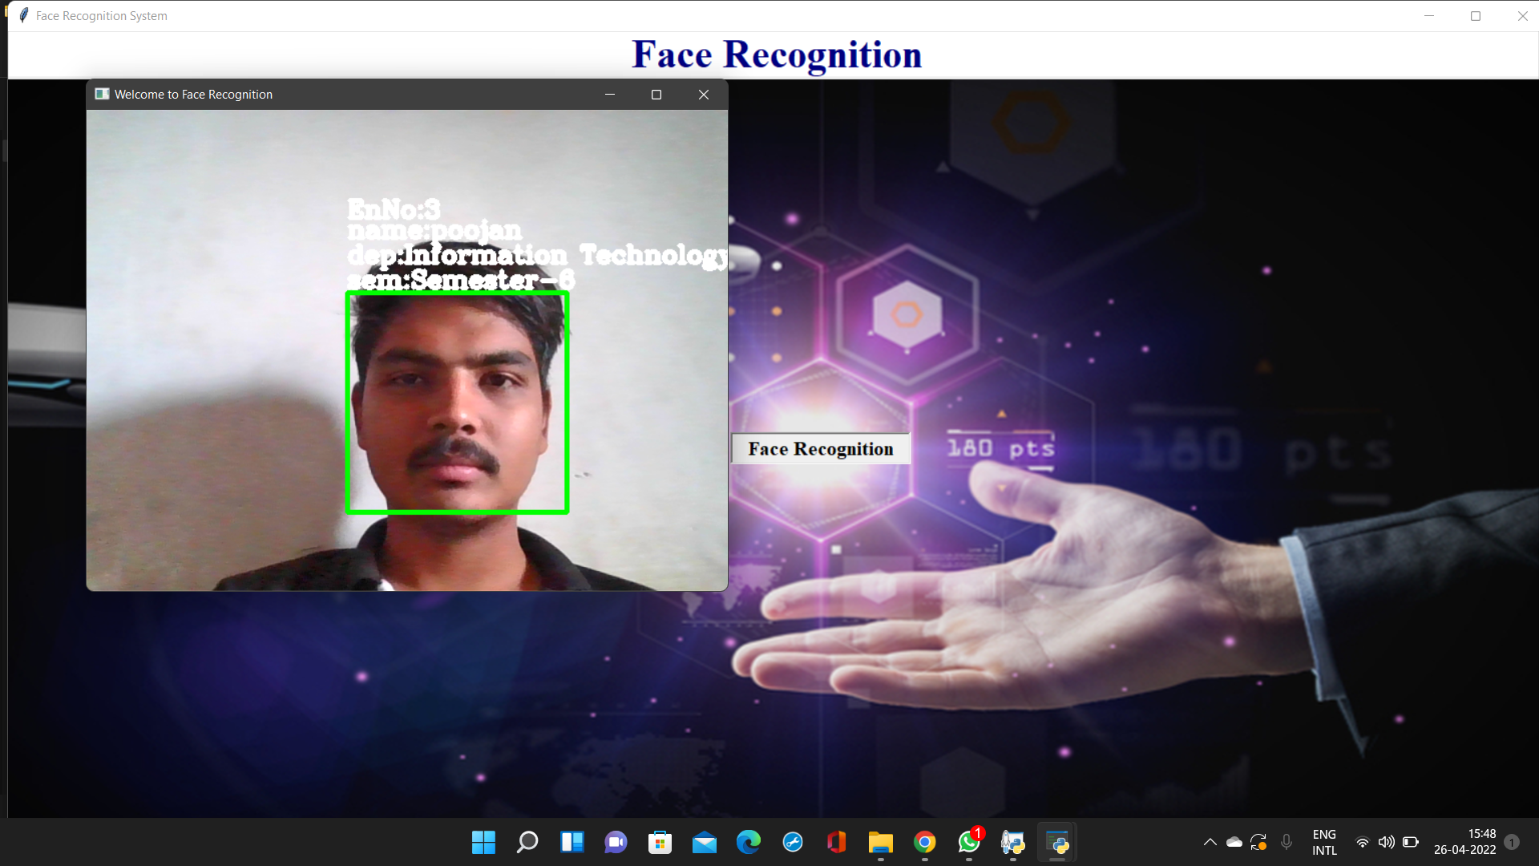
Face Recognition

Slide 25
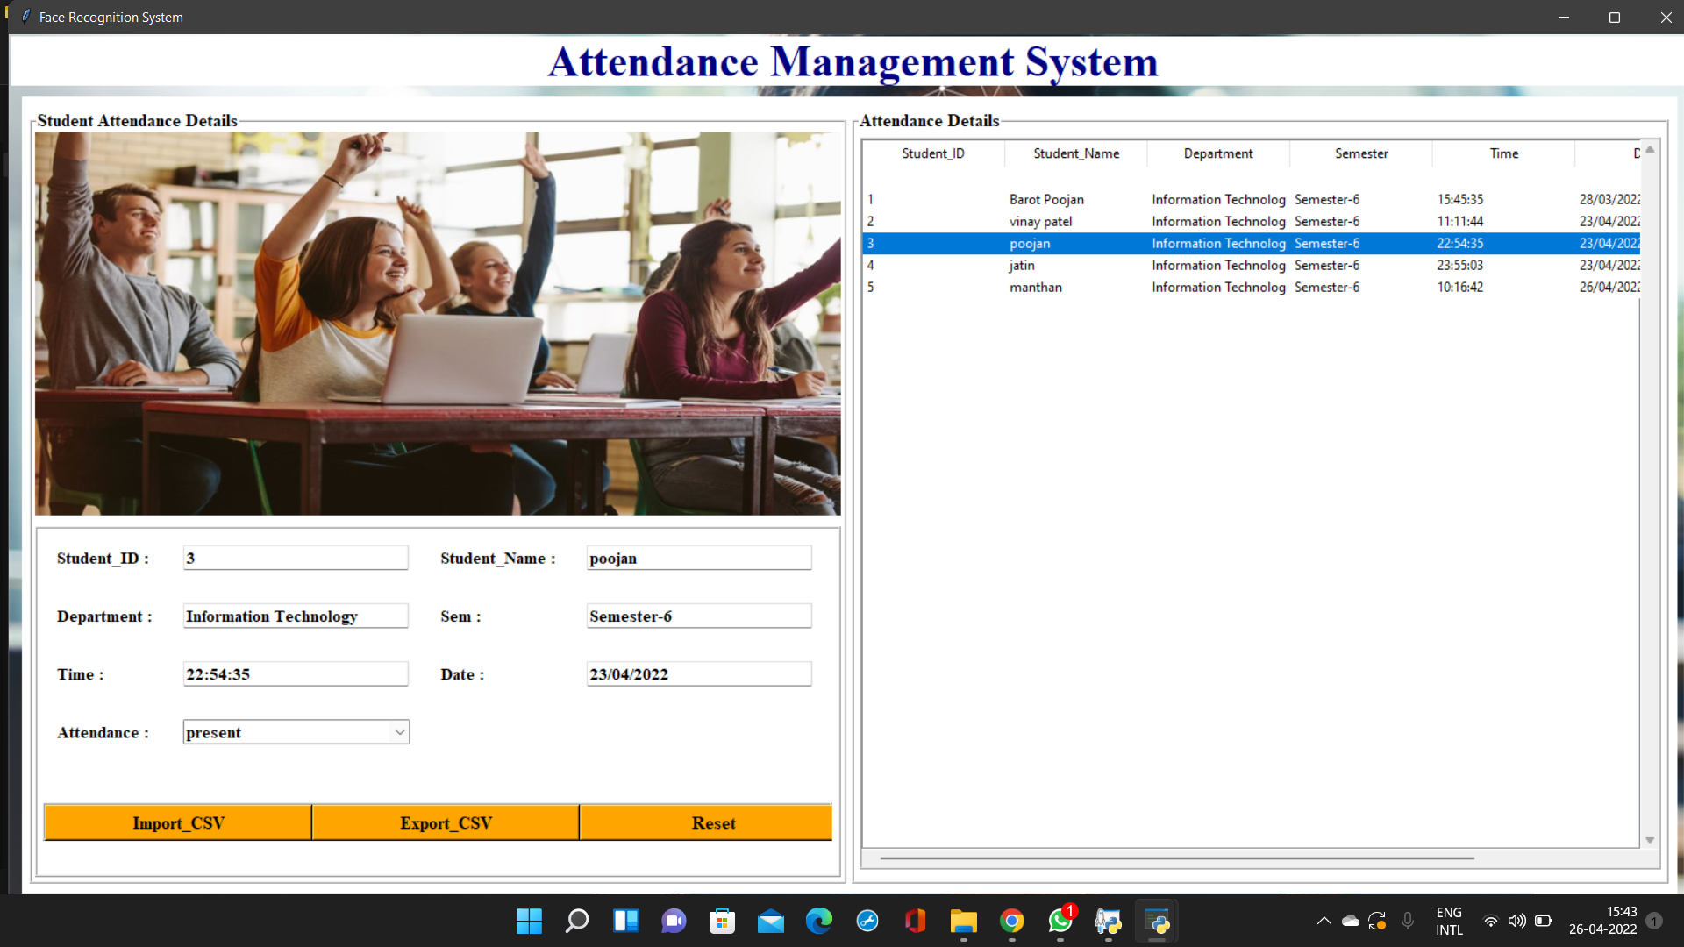
Attendance Management

Slide 26

Help Desk

Slide 27

Developer

Slide 28
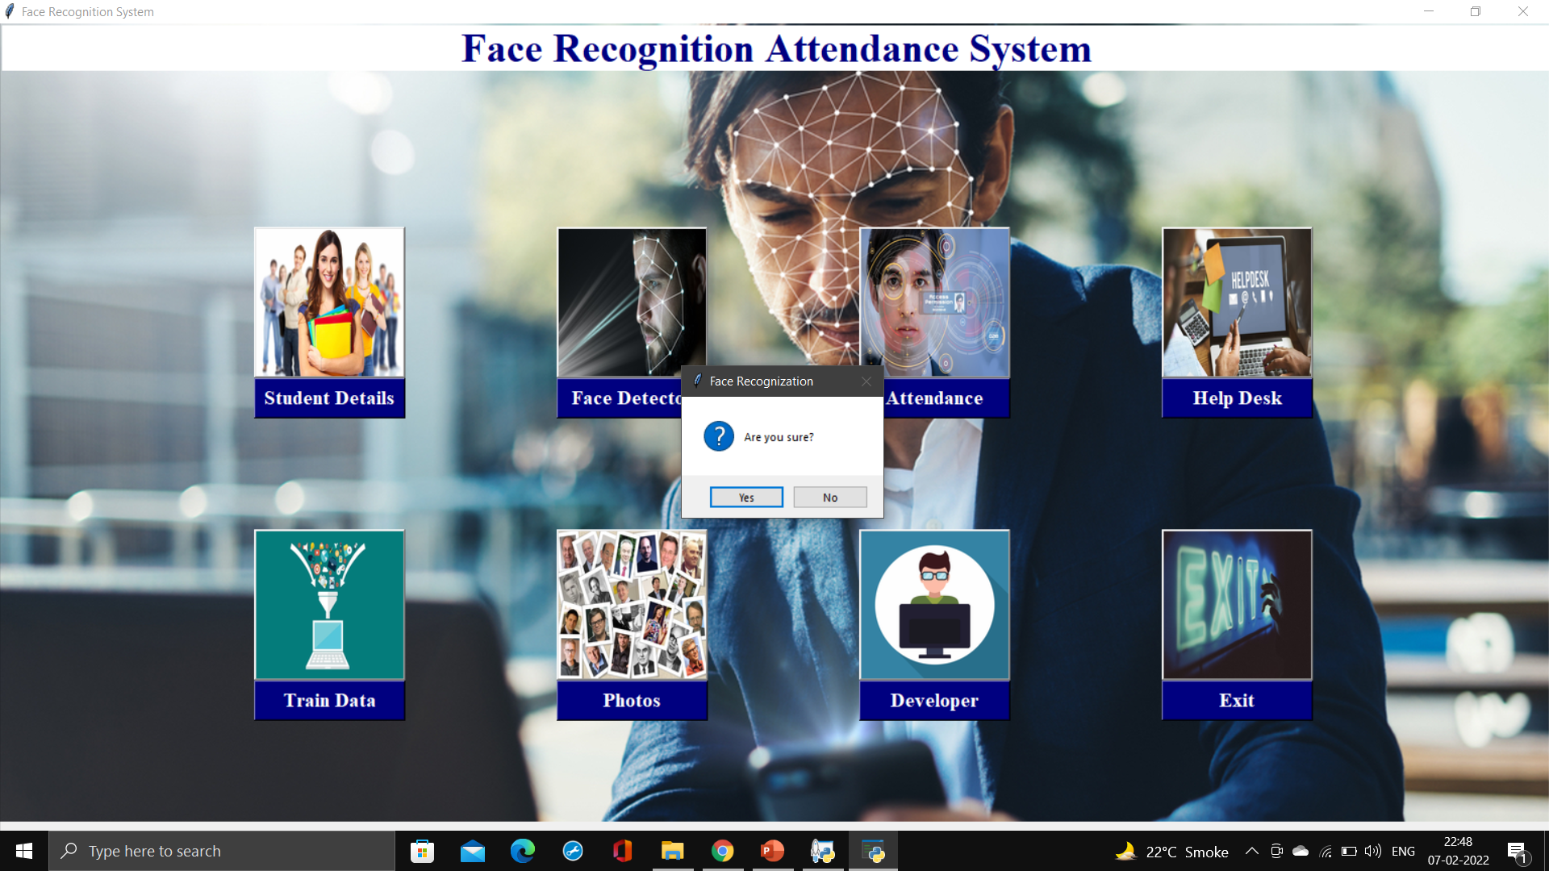
Exit

Slide 29
Conclusion

Slide 30
`Conclusion
In this paper, in order to obtain the attendance , positions and face images in classroom lecture, we proposed the attendance management system based on face recognition in the classroom lecture .
The system estimates the attendance and the position of each student by continuous observation and recording.
1
1

Slide 31
Future Scope

Slide 32
`Future Scope
We also need to discuss the approach of camera planning based on the result of the position estimation in order to improve face detection effectiveness by using the interaction among our system, the student and the teacher.
On the Other hand , our system can be improved by integrating video-streaming service and lecture archiving system, to provide more profound applications in the field of distance education, course management system and support for faculty development.
1
1

Slide 33
THANKS!
Any questions?
You can find us at:
barotpoojan91201@gmail.com
manthan12@gmail.com
krunal09@gmail.com
jigar545@gmail.com

